Slide 1
My Crypto
Portfolio
The best Alexa skill for all crypto related queries and personal portfolio details.

Slide 2
Table Of Contents
(Click on the text to navigate to the respective slide)
Commands
Data Flow
Registration Model
Machine Learning Model
Target Audience
Other Features
What Makes Us Better?

Slide 3
Commands
Account independent commands:
Invocation: start my crypto portfolio
Fetch price: what is the price of bitcoin
You can replace bitcoin with any of the supported crypto(https://mycryptoportfolio.netlify.com/support.html)
Fetch market cap: what is bitcoin's current market cap
You can replace bitcoin with any of the supported crypto (https://mycryptoportfolio.netlify.com/support.html)
Get predictions: predict the price of bitcoin on 26th october
You can get price prediction for 4 cryptos (btc, eth, ltc, doge) upto 30 days from the current date.
Fetch News: get daily news briefing on crypto by asking ‘What’s new’

Slide 4
Commands (continued)
Account dependent commands:
To run these commands you need to register your email along with your crypto addresses to our database here(https://mycryptoportfolio.netlify.com/index.html)
Unconfirmed transactions: How many unconfirmed transactions do i have?
Portfolio value: how many bitcoins am i holding?
You can replace bitcoin with (litecoin, ether, dogecoin).
What is the net worth of my portfolio : returns the total worth in USDs
(Click here to navigate to Table Of Contents)

Slide 5
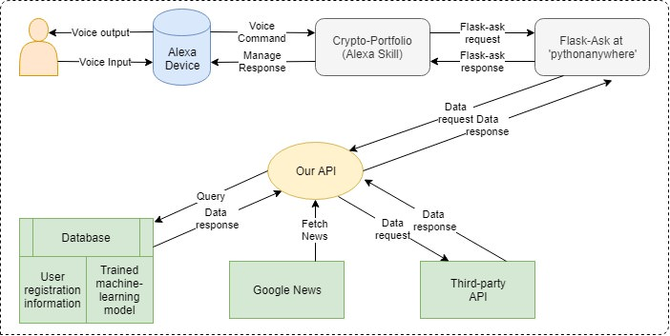
Data Flow
Fig.1 - This image depicts the flow of data in the developed Alexa skill

Slide 6
Our skill's endpoint is created in python using flask_ask and flask library. It is hosted at ‘pythonanywhere’.
We have created a completely new API from scratch dedicated to My Crypto Portfolio skill, this API has several features and it's docs can be viewed here. https://github.com/TimeTraveller-San/alexa-skill-API/blob/master/README.md
We maintain a database for our API for which our skill store user's email address after they've given the required permissions. The skill is still usable even if the users decide not to share their email with us but the functionalities are limited.
(Click here to navigate to Table Of Contents)

Slide 7
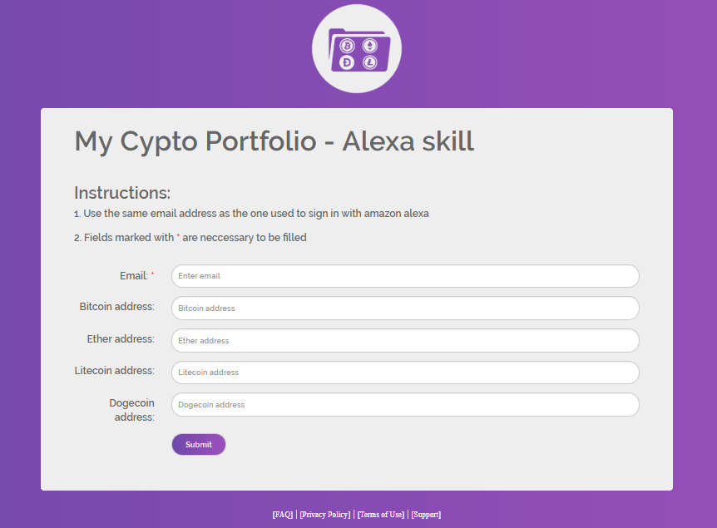
Registration Model
User registers his email along with the public keys of four of his cryptocurrency wallets through a form which has been displayed below:
Fig.2 - It depicts the form which the users shall be required to fill.

Slide 8
On clicking submit, the email ID along with the public keys (addresses) is stored into our database and are later used by the skill to fetch account details such as:
Portfolio Value:
The core of blockchain technology is a public ledger. This ledger can be viewed by anyone. Given the public key, we use bitcoin’s API to fetch the amount of coins held in the address that is stored in our database.
This public API can be viewed at: https://www.blockchain.com/btc/address/1BPyXemrs6Rb2kQdJynnxzxEVv5M2qLfa2
Similarly, other crypto details can be fetched.

Slide 9
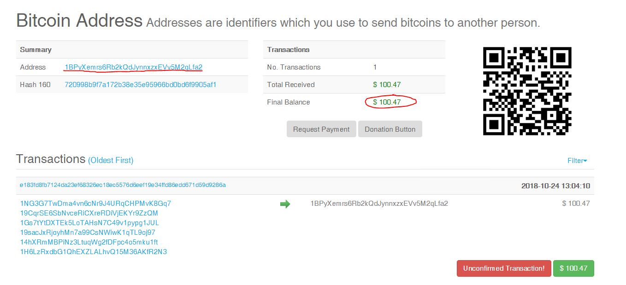
Fig.3 - It depicts the use of the cryptocurrency address provided by the user.

Slide 10
2. Unconfirmed Transactions:
Unconfirmed transaction means that the transaction has not been included in a block and thus has not been completed. This too can be fetched from the bitcoin and other crypto APIs, provided, we have their public keys.
This public API can be viewed here: https://www.blockchain.com/btc/address/1BPyXemrs6Rb2kQdJynnxzxEVv5M2qLfa2

Slide 11
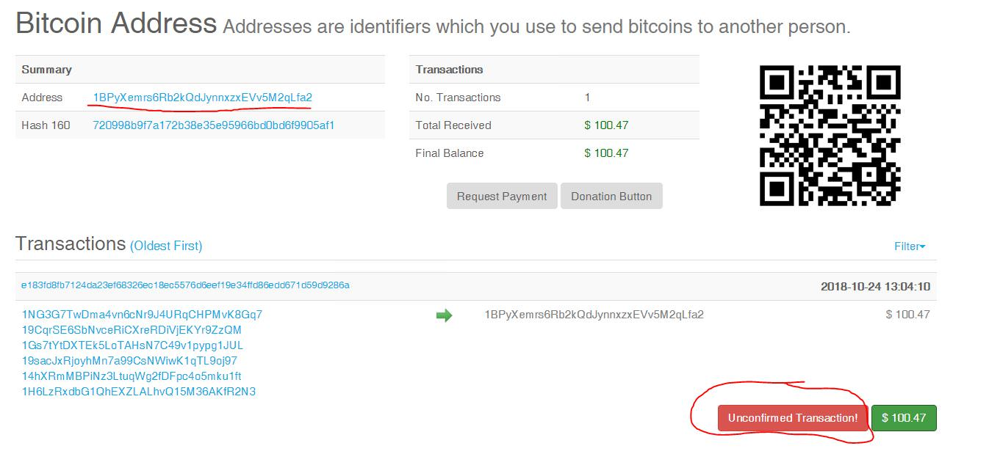
Fig.4 - It depicts the use of the cryptocurrency address to check unconfirmed transaction.

Slide 12
Our API also performs other features like:
Fetch News:
Top news articles are fetched from the Google News crypto section. This is done using web-scraping with ‘bs4’ python module. (https://news.google.com/topics/CAAqBwgKMIjl9gowp9zVAg?hl=en-IN&gl=IN&ceid=IN:en)
Price Prediction:
This is done using our Machine Learning algorithm which uses the data set regularly updated at https://coinmetrics.io/data-downloads/.
(Click here to navigate to Table Of Contents)

Slide 13
Machine Learning Model
(Click here to navigate to Table Of Contents)
Description of Prediction Model: A recent news item went as follows: “Apple buys machine learning firm Perceptio Inc., a startup, in an attempt to bring advanced image-classifying artificial intelligence to smartphones by reducing data overhead which is typically required of conventional methods.” Another recent development was that MIT researchers were working on object recognition through flexible machine learning. Machine learning is starting to reshape how we live, and it’s time we understood what it is and why it matters.
In our Alexa skill, we have applied Machine Learning in predicting the price of cryptocurrencies for the user in order to assist him to manage his crypto-currency transactions. The model learns the pattern followed by the prices of the respective cryptocurrency from its beginning to date and makes predictions for the next 30 days for the user.
However, these are simply prices predicted by an algorithm and may vary with the actual prices. We, on our part, have tried our level best to provide the user with prices predicted as close as possible to the real prices.

Slide 14
Target Audience
The generation of millenials is a strong community who support the use of cryptocurrencies and this is just the right platform for simplifying their daily management and use of cryptocurrencies.
My Crypto Portfolio offers all the needed features that a crypto savvy person might need in order to stay updated with the market.
(Click here to navigate to Table Of Contents)

Slide 15
Other Features
(Click here to navigate to Table Of Contents)
API endpoint: https://www.coindesk.com/api/
We use the coindesk free API according it's TOC we are allowed to use this API with our skill until we start monetizing it which is when we need to buy the API.
We can perform various functions with this such as:
Fetch price of 50+ cryptocurrencies:
We can fetch price of all cryptos listed on our website support (https://mycryptoportfolio.netlify.com/support.html)
Our skill not only reads the price but also present the net gain/loss in the price.
Fetch net market cap of 50+ cryptocurrencies:
We can fetch current market cap of all cryptos listed on our website support (https://mycryptoportfolio.netlify.com/support.html)

Slide 16
What Makes Us Better?
We conducted a brief comparative study on other cryptocurrency wallets handling user accounts and displaying information related to them.
The comparison revealed that unlike any other such wallets on the Alexa Skill Store, My Crypto Portfolio doesn’t require the user to update his wallet with Alexa after he/she performs any action using his crypto-account.
My Crypto Portfolio uses the address provided by the user and thus automatically keeps the updated knowledge about the user’s wallet.
There is no effort which is required from the user’s side to update knowledge about his wallet on his/her Alexa device.
(Click here to navigate to Table Of Contents)

Slide 17



My Crypto Portfolio developer team : Vaibhav Kumar, Siddhant Bhambri & Utsav Dahiya.

Slide 18
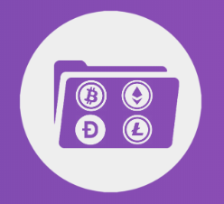
Thank you!

